Slide 1
Python Tutorial
By Alok kumar Nayak

Slide 2
Installation of Python
Install Python on Windows
First, download the latest version of Python from the download page.
Go to www.python.org and download latest version of python

Slide 3
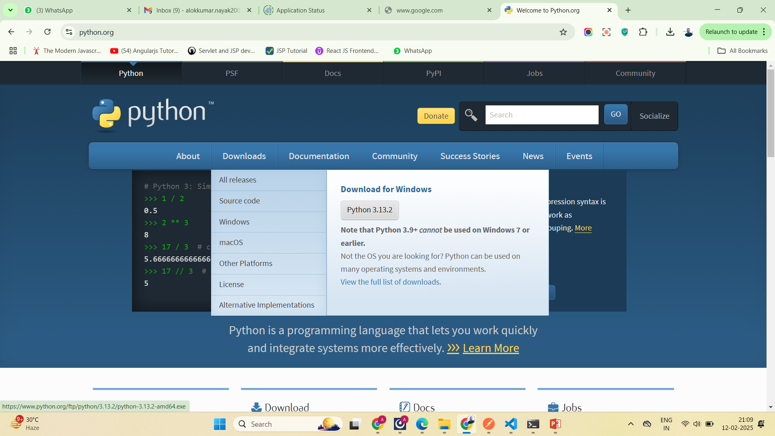

Slide 4
Continued…
Second, double-click the installer file to launch the setup wizard.

Slide 5
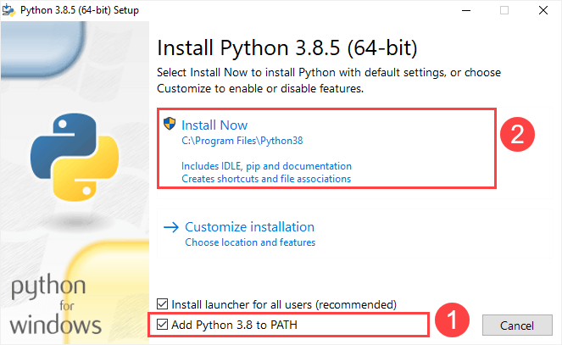
Continued..

Slide 6
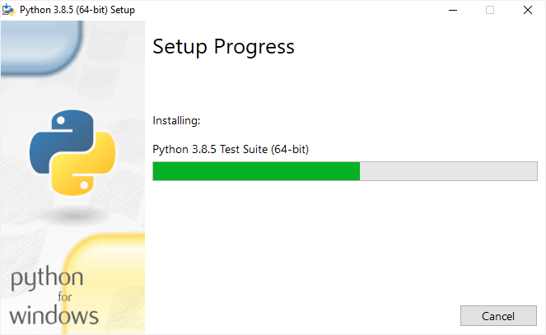
Continued..

Slide 7
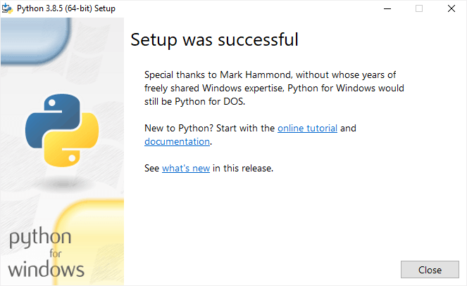
Continued..

Slide 8
Verify the installation
To verify the installation, you open the Run window and type cmd and press Enter:

Slide 9
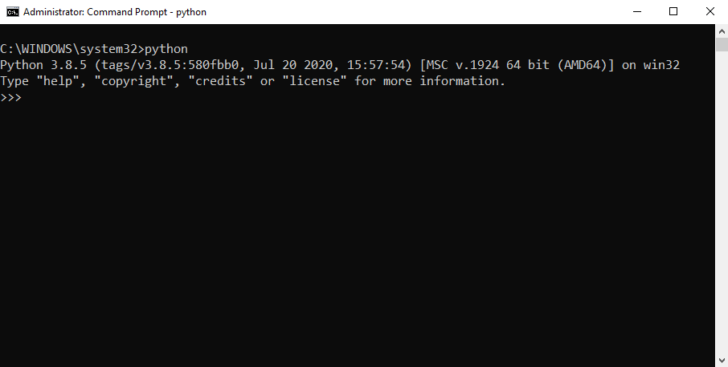
Continued..

Slide 10
Continued..
If you see the following output from the Command Prompt after typing the python command:
'python' is not recognized as an internal or external command, operable program or batch file.
Likely, you didn’t check the Add Python 3.8 to PATH checkbox when you install Python.

Slide 11
Continued..
If you see the following output from the Command Prompt after typing the python command:
'python' is not recognized as an internal or external command, operable program or batch file.
Likely, you didn’t check the Add Python 3.8 to PATH checkbox when you install Python.

